Slide 1
Video Surveillance CNZ
An introductory presentation
BTECH 450DT, Presented by Mao Cai

Slide 2
Overview
Organizations
Project description
Project plan
What can I gain

Slide 3
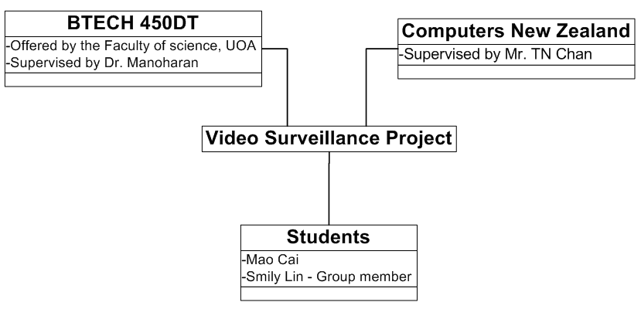
Organizations
Two organizations and two individuals are involved in the project.

Slide 4

Computers New Zealand
Computers New Zealand (CNZ) is a total information system and solutions provider
provides IT consulting advice, hardware platforms, software and support services.
CNZ is focussed on 2 solutions :
Information Systems
Video Surveillance Systems
CNZ has researched into IP based video surveillance technology and has commercialized successfully.

Slide 5
Project description
Video Surveillance – a wide range of contents
CCTV & IPVS two technologies
Different devices and implementations
This project is research based, divides into a few parts
Research on fundamentals – technologies and hardware
IPVS system installation and configuration
Research on IPVS related topics – Ethernet, POE etc.
Programming – NVR and video analytics applications
System control; motion analyzing etc.
Build a commercial (fully) digitized video surveillance system starting from scratch.

Slide 6
Current work
Research on:
Differences between IPVS and CCTV in terms of technology functions and hardware used
Related hardware – IP cameras and analogue cameras
Digitized – easy, powerful

Slide 7
Planning
Term 1 – study on established technologies and products.
Term 2 – research and implementation (technologies in development) .
Session | Mao Cai | Smily Lin
1 | Differences between IPVS and CCTV
2 | Differences between IP & Analogue Camera
3 | Connection to LAN and Internet & Storage
4 | Setup IP Camera | Setup Analogue Camera & DVR
5 | Setup NVR | Setup NAS & DVR IP
6 | Ethernet, PoE, Switches | Wireless & LAN
7 | Review and Summarise | Review and Summarise

Slide 8
What can I gain
Valuable industrial/academic experience:
Combination of hardware and software
Convert a new technology to a commercial product
Networks issues - More professional
Solve real life technical problems
Research, presentation and report techniques

Slide 9
Thank you

